Slide 1
Lecture 9: Models with movement
May 22, 2018
Learning goals:
Understand theory of advective-diffuse movement models
Understand how to specify a sparse advective-diffusive movement matrix

Slide 2
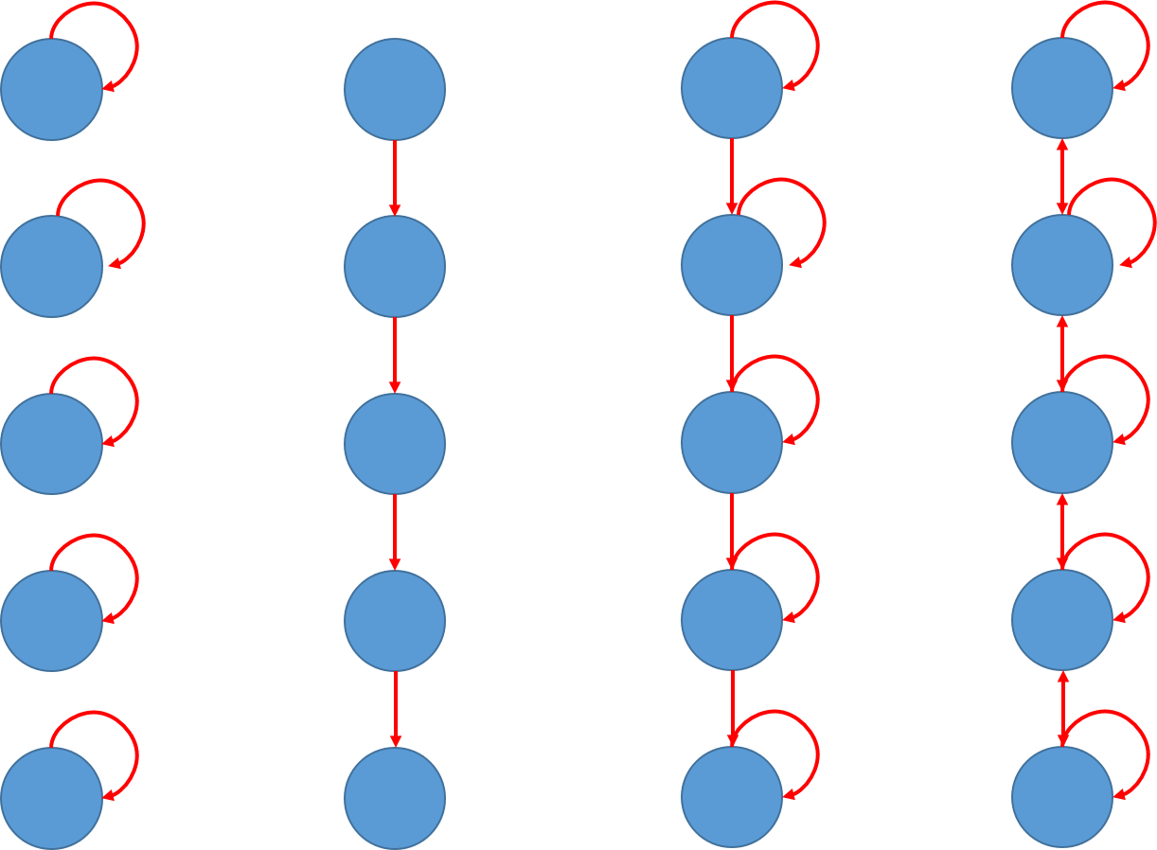
Different forms of movement
No movement
Rail car
Partial migration
Diffusion

Slide 3

Different forms of movement
$$\frac{d}{dt}b=Mb$$
M =
No movement
1
 | 1
 |  | 1
 |  |  | 1
 |  |  |  | 1

Slide 4
Different forms of movement
$$\frac{d}{dt}b=Mb$$
M =
Rail car
1
 | 1
 |  | 1
 |  |  | 1 | 1
Notes:
M is a column stochastic matrix—from column to row?
Each column is the distribution/prob of moving from state in column j to state in row i

Slide 5
Different forms of movement
$$\frac{d}{dt}b=Mb$$
M =
Partial migration
1-p
p | 1-p
 | p | 1-p
 |  | p | 1-p
 |  |  | p | 1

Slide 6
Different forms of movement
$$\frac{d}{dt}b=Mb$$
M =
Diffusion
1-p | p
p | 1-2p | p
 | p | 1-2p | p
 |  | p | 1-2p | p
 |  |  | p | 1-p
Notes:
Constraint on p– must be less than 0.5 to sum to 1

Slide 7
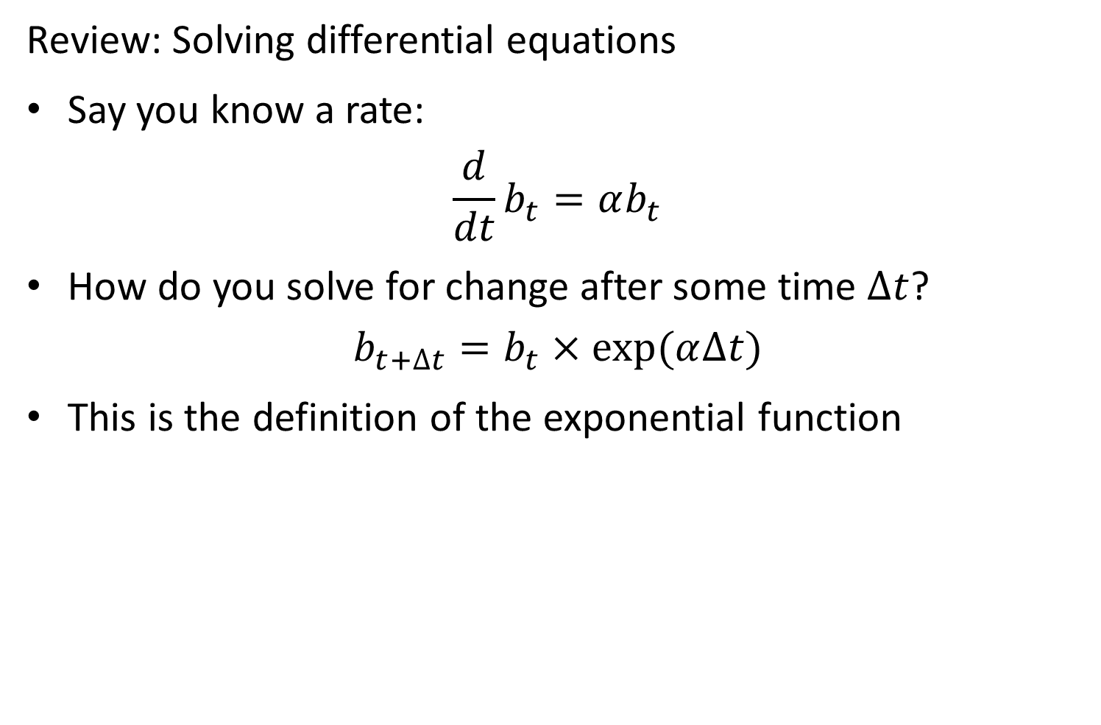
Review: Solving differential equations
Say you know a rate:
$$\frac{d}{dt}b_{t}=αb_{t}$$
How do you solve for change after some time $∆t$?
$$b_{t+∆t}=b_{t}×exp⁡(α∆t)$$
This is the definition of the exponential function

Slide 8
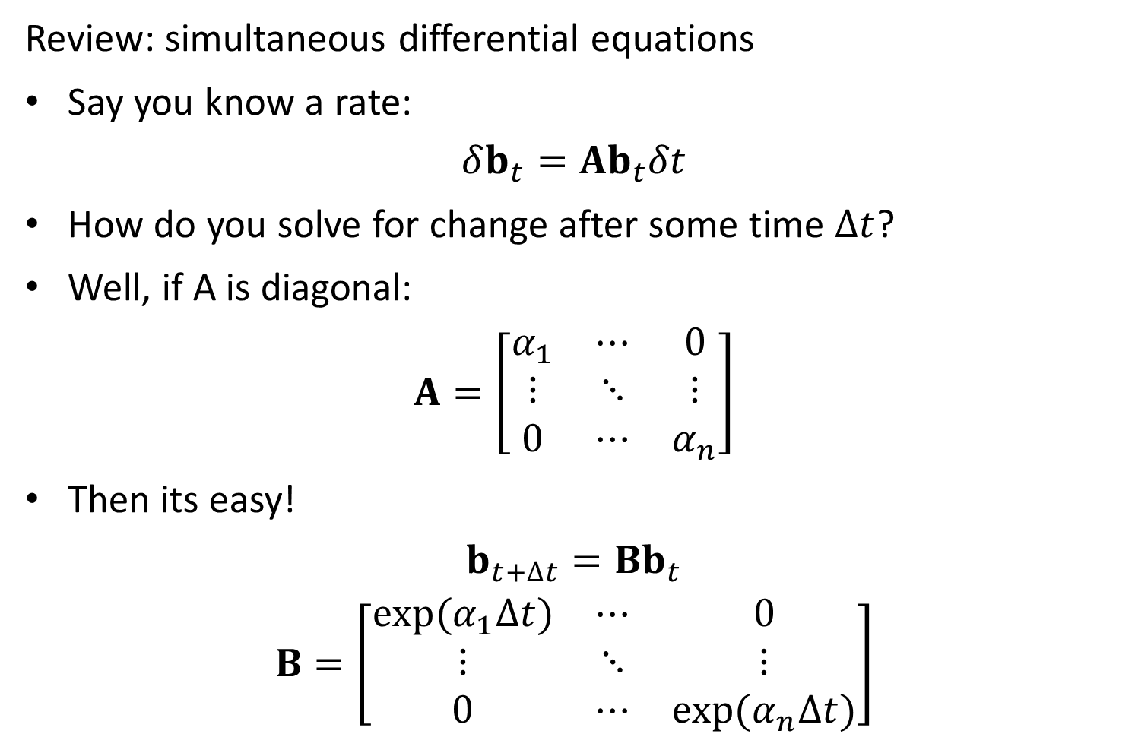
Review: simultaneous differential equations
Say you know a rate:
$$δb_{t}=Ab_{t}δt$$
How do you solve for change after some time $∆t$?
Well, if A is diagonal:
$$A=\left[\begin{matrix}α_{1} & ⋯ & 0 \\ ⋮ & ⋱ & ⋮ \\ 0 & ⋯ & α_{n}\end{matrix}\right]$$
Then its easy!
$$b_{t+∆t}=Bb_{t}$$
$$B=\left[\begin{matrix}exp⁡(α_{1}∆t) & ⋯ & 0 \\ ⋮ & ⋱ & ⋮ \\ 0 & ⋯ & exp⁡(α_{n}∆t)\end{matrix}\right]$$

Slide 9
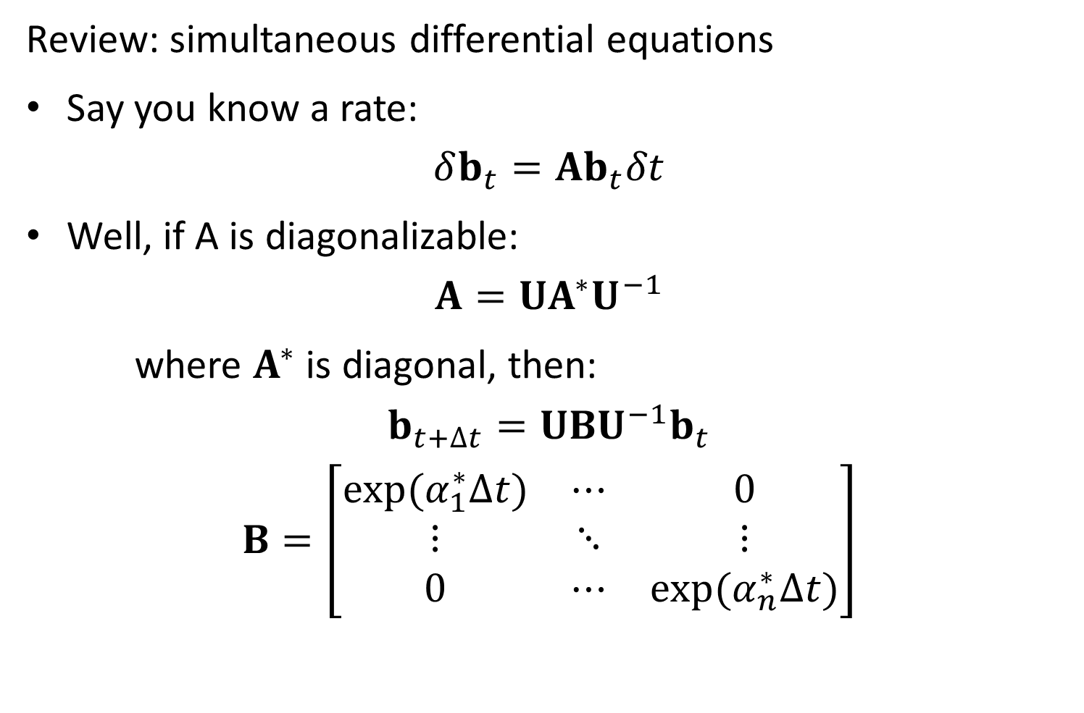
Review: simultaneous differential equations
Say you know a rate:
$$δb_{t}=Ab_{t}δt$$
Well, if A is diagonalizable:
$$A=UA^{∗}U^{−1}$$
where $A^{∗}$ is diagonal, then:
$$b_{t+∆t}=UBU^{−1}b_{t}$$
$$B=\left[\begin{matrix}exp⁡(α_{1}^{∗}∆t) & ⋯ & 0 \\ ⋮ & ⋱ & ⋮ \\ 0 & ⋯ & exp⁡(α_{n}^{∗}∆t)\end{matrix}\right]$$

Slide 10
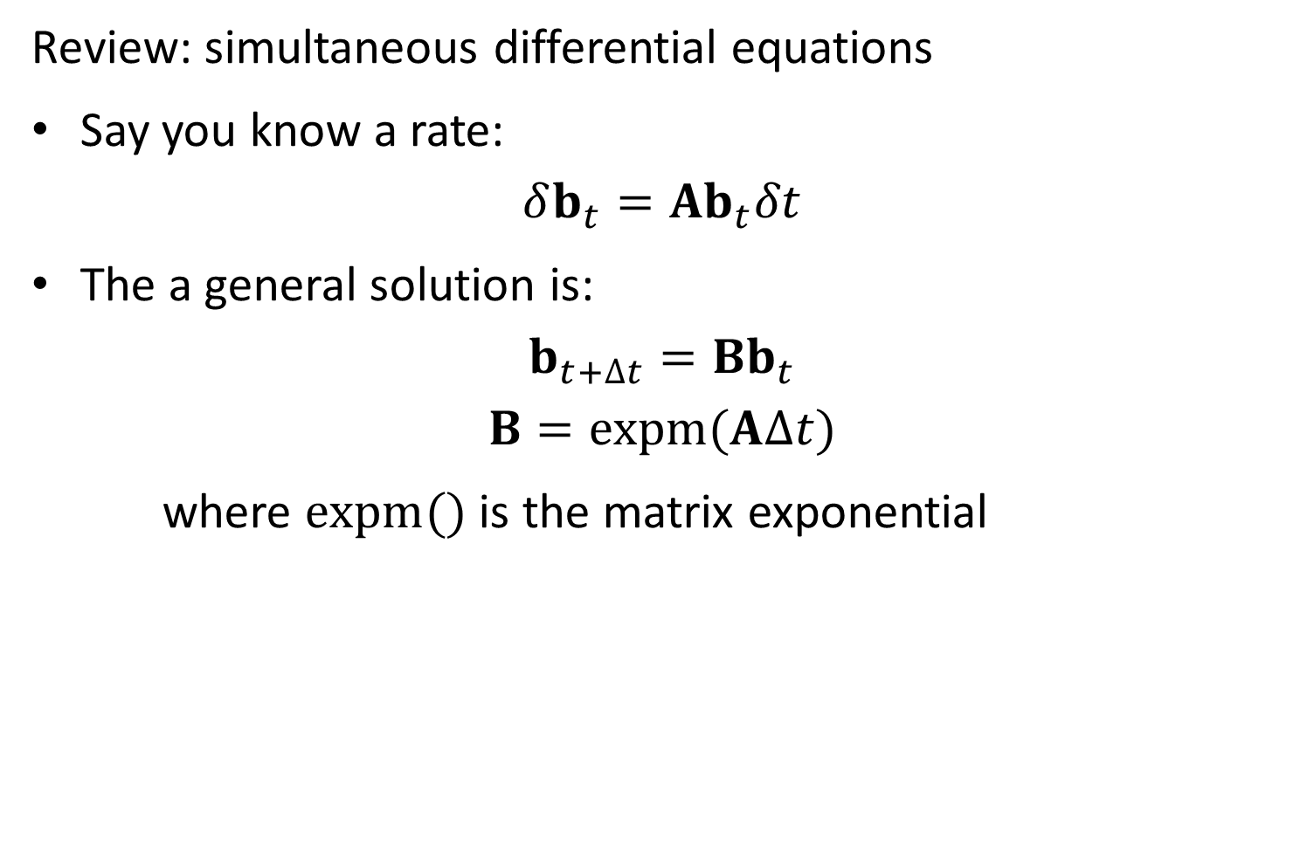
Review: simultaneous differential equations
Say you know a rate:
$$δb_{t}=Ab_{t}δt$$
The a general solution is:
$$b_{t+∆t}=Bb_{t}$$
$$B=expm(A∆t)$$
where $expm()$ is the matrix exponential

Slide 11
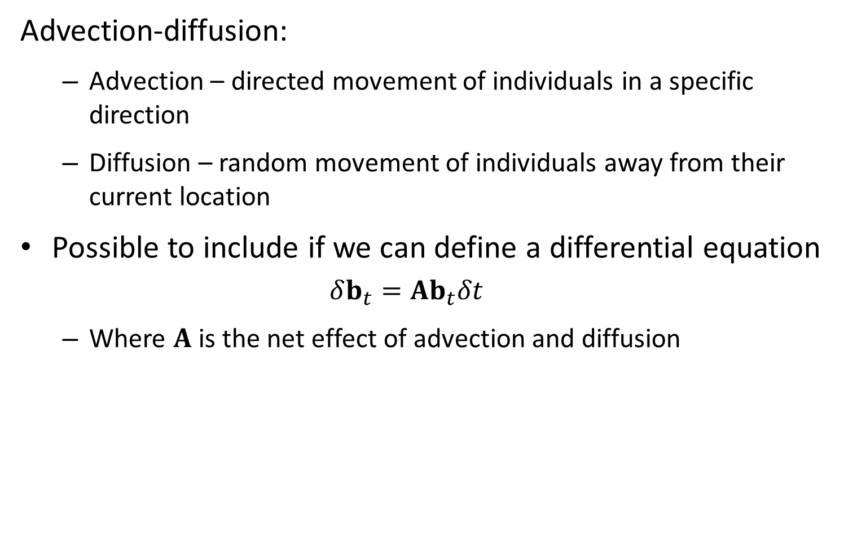
Advection-diffusion:
Advection – directed movement of individuals in a specific direction
Diffusion – random movement of individuals away from their current location
Possible to include if we can define a differential equation
$$δb_{t}=Ab_{t}δt$$
Where $A$ is the net effect of advection and diffusion

Slide 12


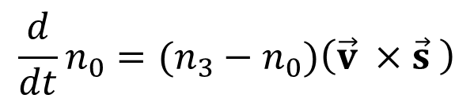

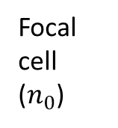
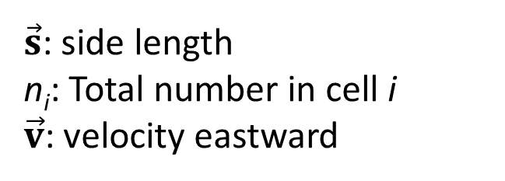



$\vec{s}$: side length
n_{i}: Total number in cell i
$\vec{v}$: velocity eastward
Neighbor 2 ($n_{2}$)
Neighbor 3 ($n_{3}$)
Focal cell ($n_{0}$)
Neighbor 1 ($n_{1}$)
$$\vec{v}$$
$$\vec{s}$$
Neighbor 4 ($n_{4}$)
$$\frac{d}{dt}n_{0}=(n_{3}−n_{0})\left(\vec{v} ×\vec{s} \right)$$
Notes:
Crossproduct with parallel sides gives zero, so advection only occurs across sides that are perpendicular to the direction of flow

Slide 13



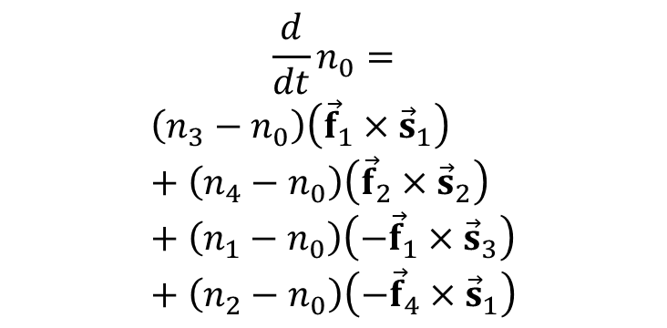
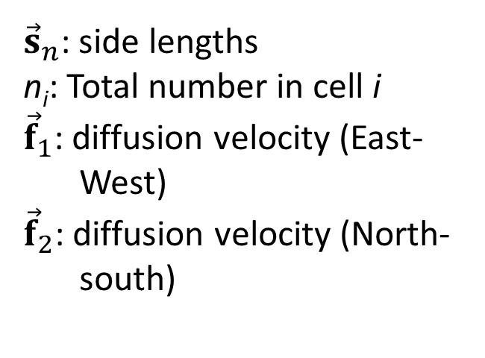



$${\vec{s}}_{2}$$
${\vec{s}}_{n}$: side lengths
n_{i}: Total number in cell i
${\vec{f}}_{1}$: diffusion velocity (East-West)
${\vec{f}}_{2}$: diffusion velocity (North-south)
Neighbor 2 ($n_{2}$)
$${\vec{s}}_{3}$$
Neighbor 3 ($n_{3}$)
Focal cell ($n_{0}$)
$${\vec{f}}_{2}$$
Neighbor 1 ($n_{1}$)
$${\vec{f}}_{1}$$
$${\vec{s}}_{1}$$
Neighbor 4 ($n_{4}$)
$$\frac{d}{dt}n_{0}=$$
$$\left(n_{3}−n_{0}\right)\left({\vec{f}}_{1}×{\vec{s}}_{1}\right)+\left(n_{4}−n_{0}\right)\left({\vec{f}}_{2}×{\vec{s}}_{2}\right)+\left(n_{1}−n_{0}\right)\left(−{\vec{f}}_{1}×{\vec{s}}_{3}\right)+\left(n_{2}−n_{0}\right)\left(−{\vec{f}}_{4}×{\vec{s}}_{1}\right)$$
$${\vec{s}}_{4}$$
Notes:
Sum the movement rates in the four different directions

Slide 14


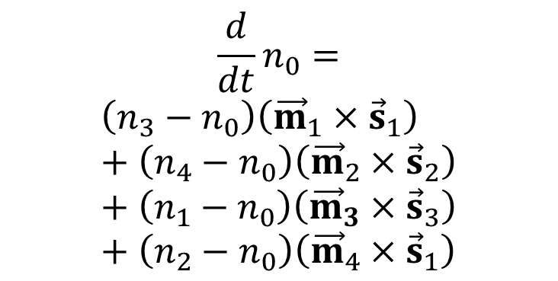

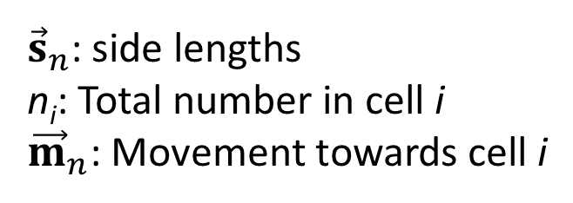

$${\vec{s}}_{2}$$
${\vec{s}}_{n}$: side lengths
n_{i}: Total number in cell i
${\vec{m}}_{n}$: Movement towards cell i
Neighbor 2 ($n_{2}$)
$${\vec{s}}_{3}$$
Neighbor 3 ($n_{3}$)
Focal cell ($n_{0}$)
$${\vec{m}}_{2}$$
Neighbor 1 ($n_{1}$)
$${\vec{m}}_{1}$$
$${\vec{s}}_{1}$$
$${\vec{m}}_{3}$$
$${\vec{m}}_{4}$$
Neighbor 4 ($n_{4}$)
$$\frac{d}{dt}n_{0}=$$
$$\left(n_{3}−n_{0}\right)\left({\vec{m}}_{1}×{\vec{s}}_{1}\right)+\left(n_{4}−n_{0}\right)\left({\vec{m}}_{2}×{\vec{s}}_{2}\right)+\left(n_{1}−n_{0}\right)\left({\vec{m}}_{3}×{\vec{s}}_{3}\right)+\left(n_{2}−n_{0}\right)\left({\vec{m}}_{4}×{\vec{s}}_{1}\right)$$
$${\vec{s}}_{4}$$

Slide 15
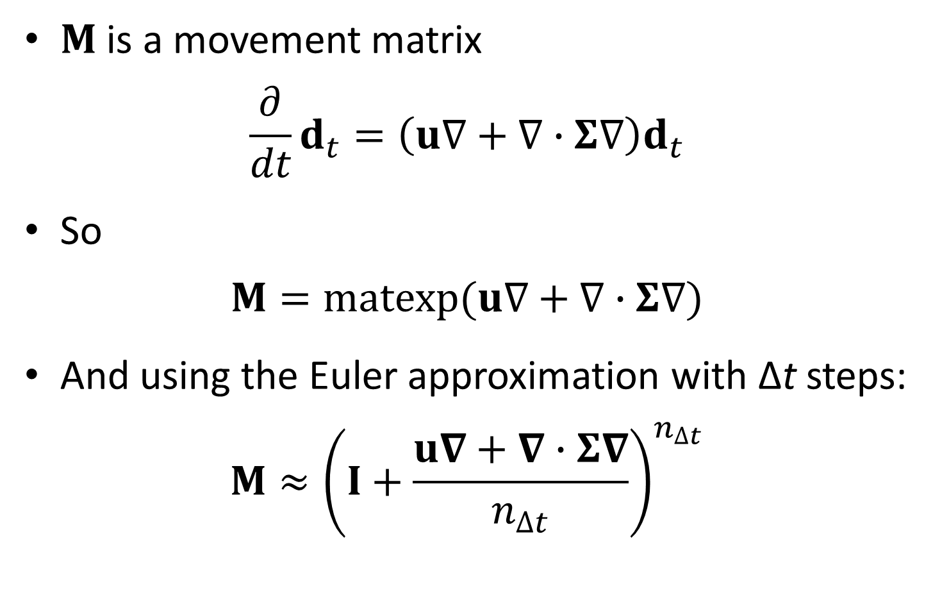
Movement math
$M$ is a movement matrix
$$\frac{∂}{dt}d_{t}=\left(u∇+∇∙Σ∇\right)d_{t}$$
So
$$M=matexp(u∇+∇∙Σ∇)$$
And using the Euler approximation with Δt steps:
$$M≈{\left(I+\frac{u∇+∇∙Σ∇}{n_{∆t}}\right)}^{n_{∆t}}$$

Slide 16
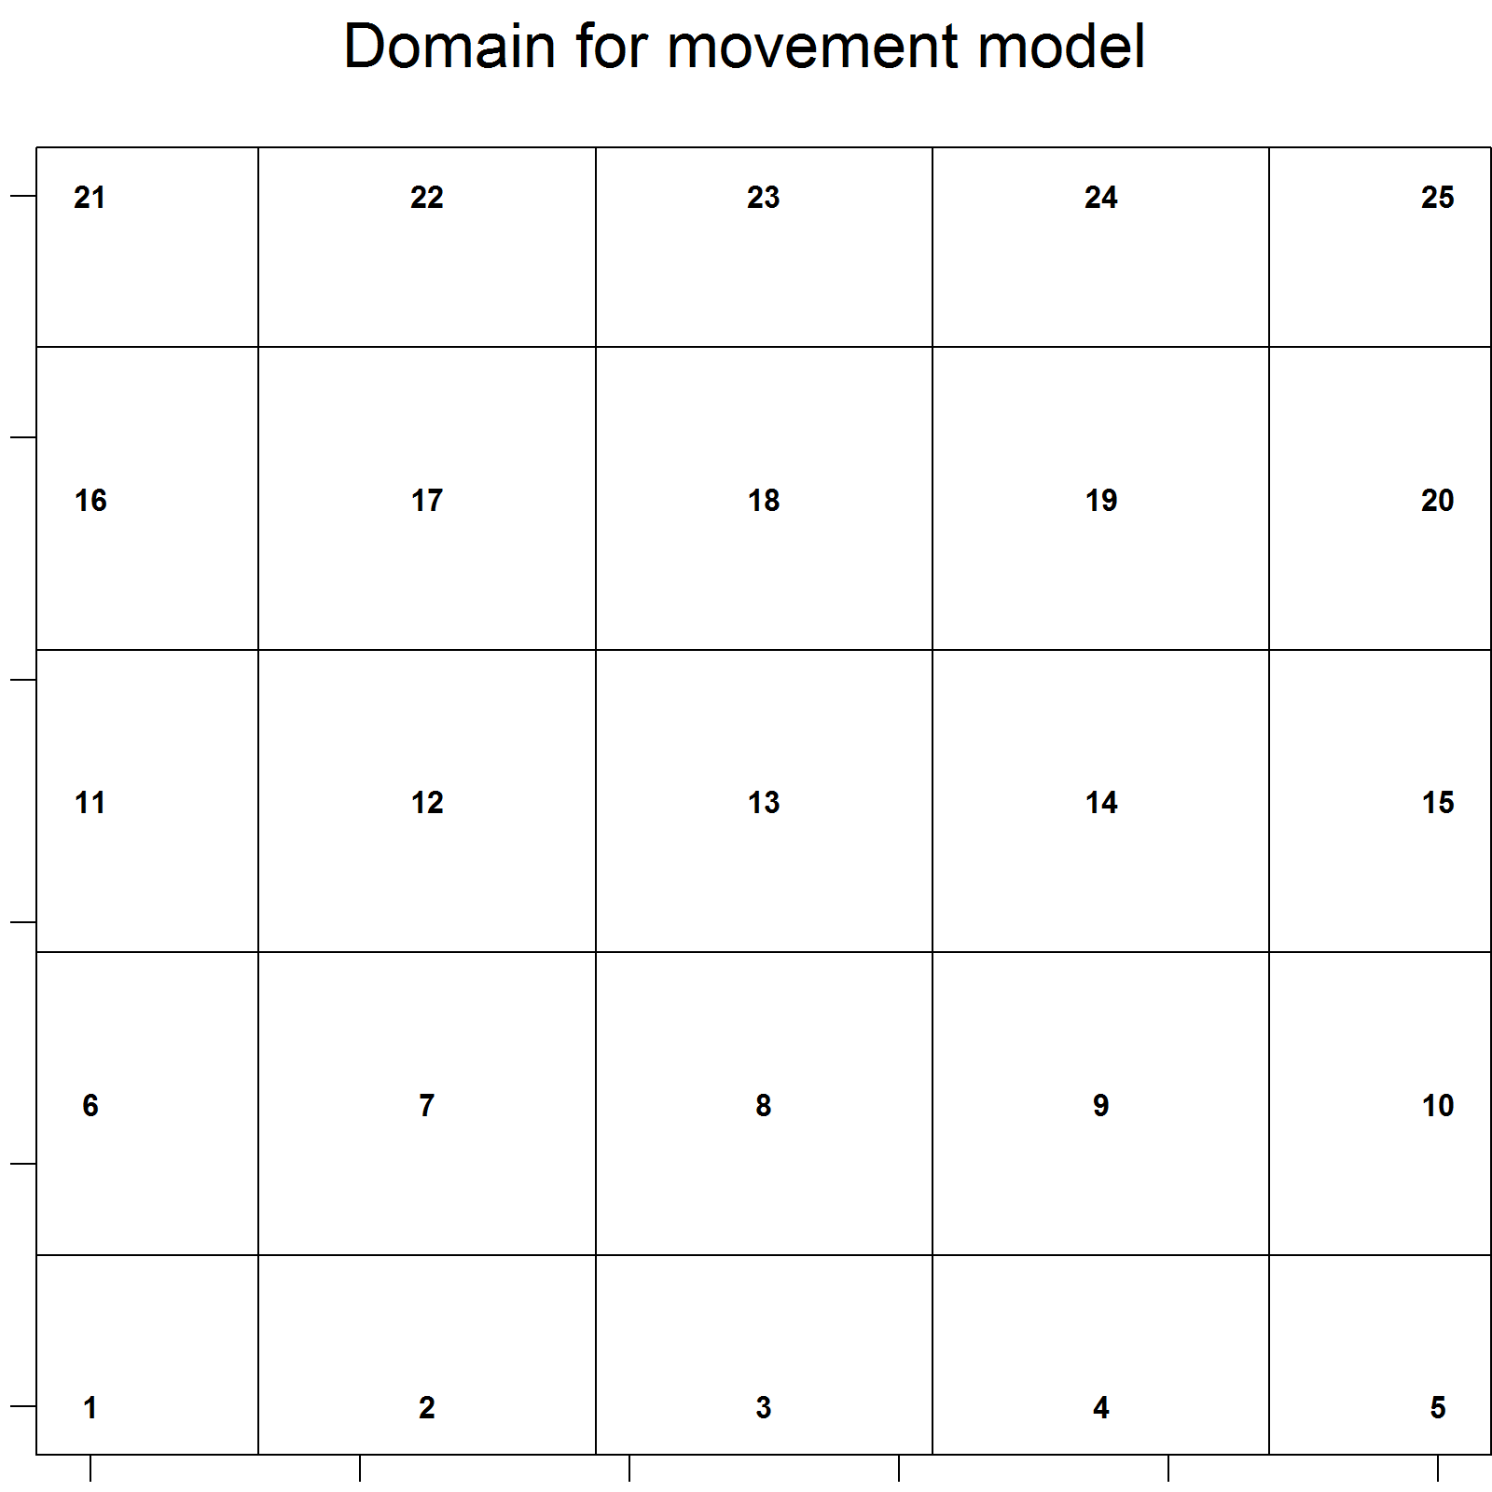
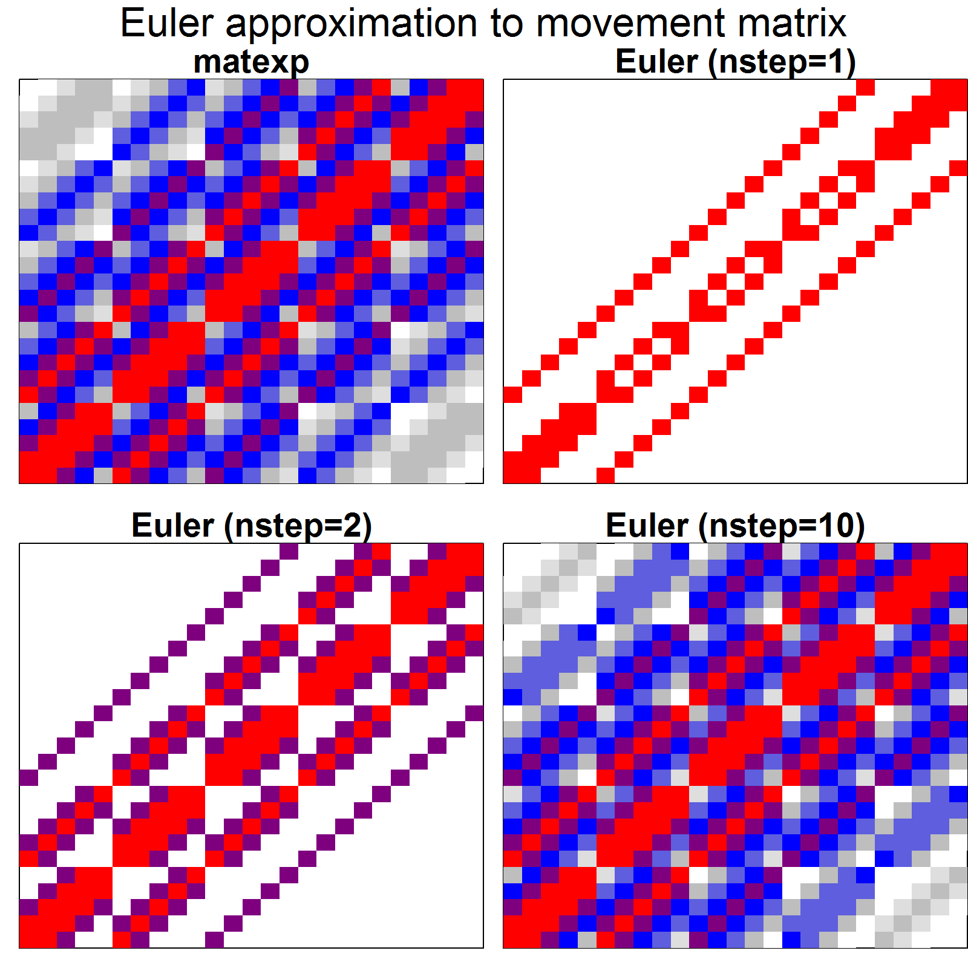
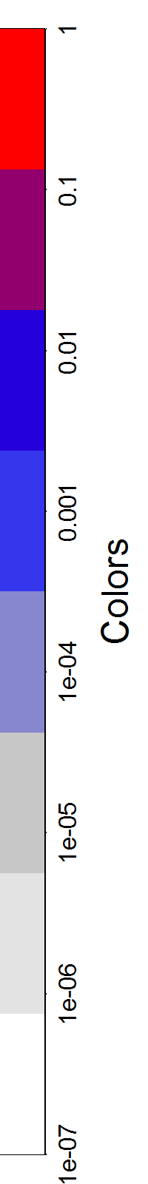
Movement math
Euler approximation is sparse!
Sparseness / accuracy scales with number of steps
Notes:
And sparseness means fast
As the number of time steps increase, the approximation gets more and more dense (animals have more places they can move to)
You would lose accuracy by applying the single-step transition matrix at each time point rather than calculating the 10 step one
(trade offs between 1 step transition ten times vs 10 step transition 1 times)
Since it’s approximating the exponential with a linear function

Slide 17
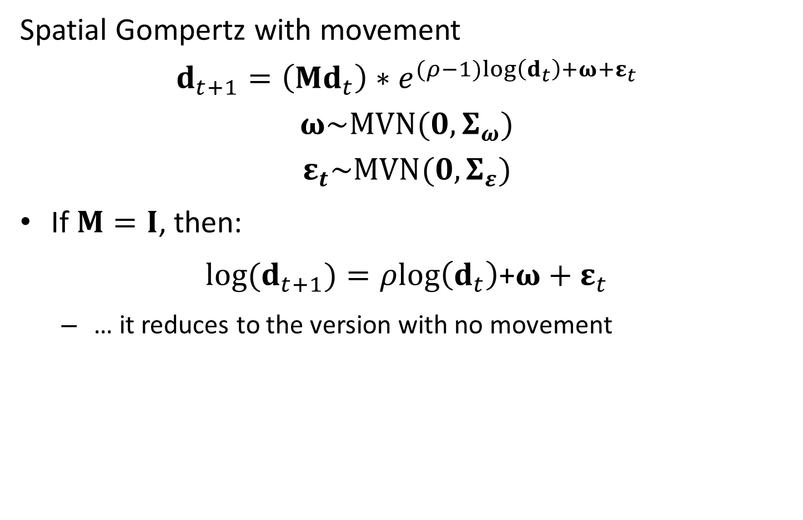
Movement math
Spatial Gompertz with movement
$$d_{t+1}=\left(Md_{t}\right)∗e^{(ρ−1)log\left(d_{t}\right)+ω+ε_{t}}$$
$$ω\sim MVN(0,Σ_{ω})$$
$$ε_{t}\sim MVN(0,Σ_{ε})$$
If $M=I$, then:
$log(d_{t+1})=ρlog\left(d_{t}\right)$+$ω+ε_{t}$
… it reduces to the version with no movement
Notes:
RHS exp() part is just the spatial gompertz model without movement

Slide 18

Movement math
Innovations parameterization
$$d_{t+1}=\left(Md_{t}\right)∗e^{(ρ−1)log\left(d_{t}\right)+ω+ε_{t}}$$
$$ω\sim MVN(0,Σ_{ω})$$
$$ε_{t}\sim MVN(0,Σ_{ε})$$
State-space parameterization
$${\hat{d}}_{t+1}=\left(Md_{t}\right)∗e^{\left(ρ−1\right)log\left(d_{t}\right)+ω}$$
$$ω\sim MVN(0,Σ_{ω})$$
$${log(d}_{t})\sim MVN(log({\hat{d}}_{t}),Σ_{ε})$$
Notes:
State-space version- treat density as a random effect, since in some cases this parameterization is faster?
Q: seems like speed was a big point, but not sure there was a clear picture about when/why some models are faster?
Q: use Gompertz here because the population size has some change to it, not just constant?

Slide 19
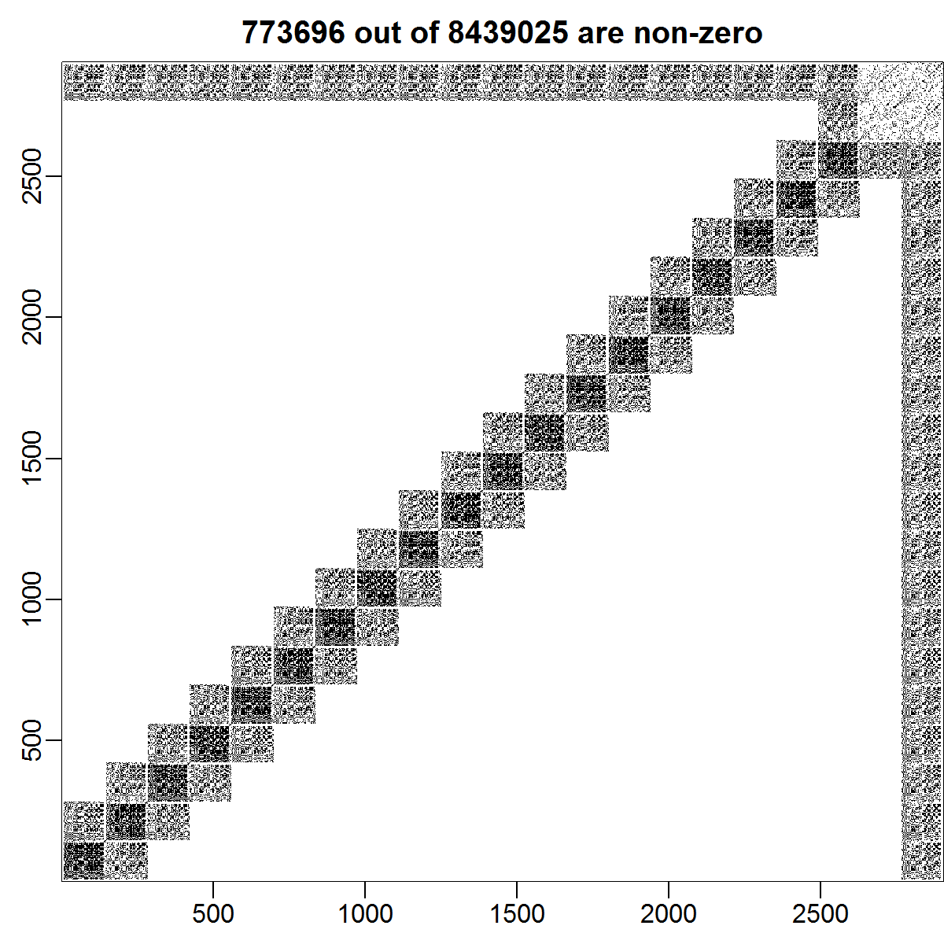
Movement math
Sparse matrix
Easier computation
Less computer memory
Faster speed

Slide 20
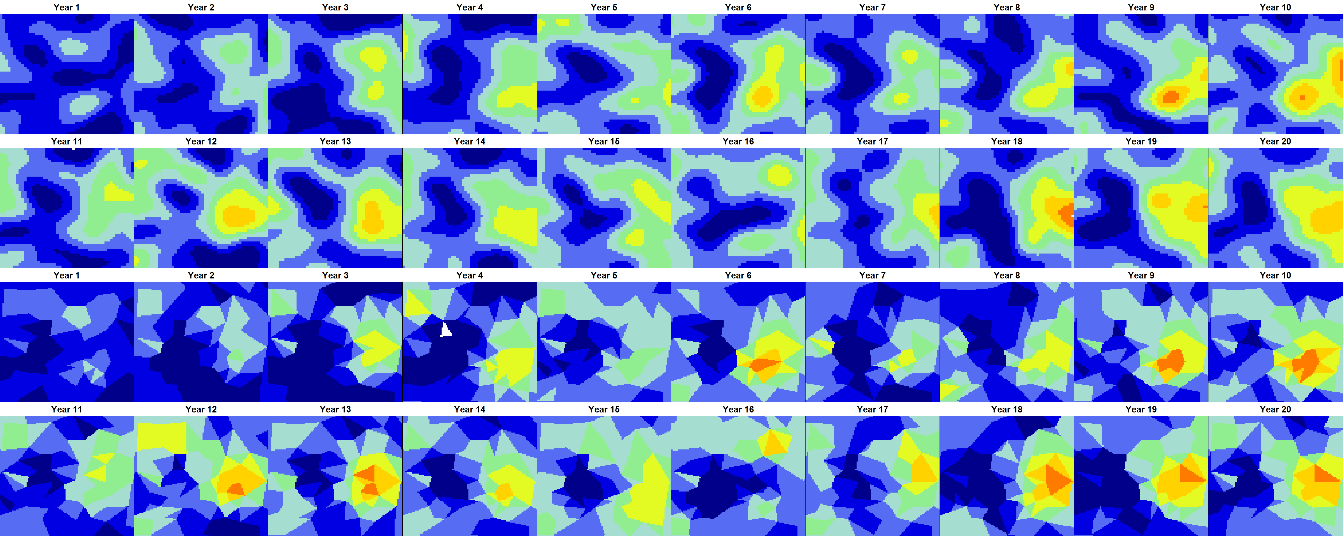
Movement math
Highly separable computation
200 triangles + 20 years = 5 min. on laptop
Seems to recovery dynamics and density
Est / True
Est / True

Slide 21
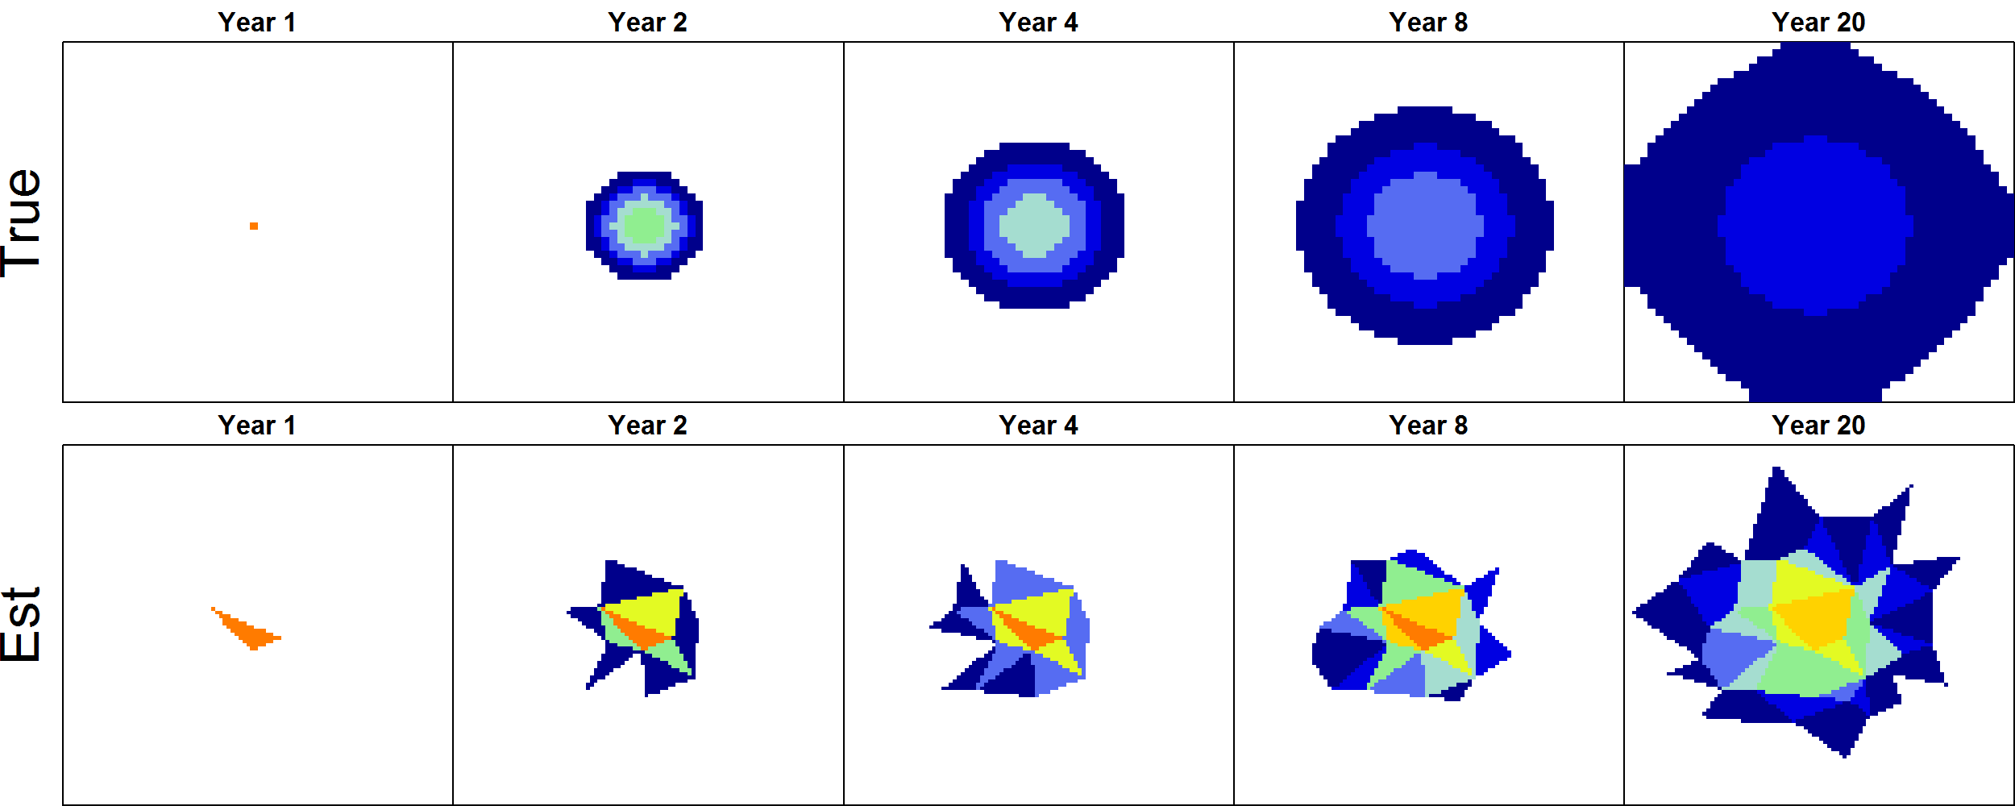
Movement math
Movement can be estimated using count data
Euler approximation is sufficient for local advection-diffusion
Notes:
Represent the process with triangles in the estimation model

